Slide 1
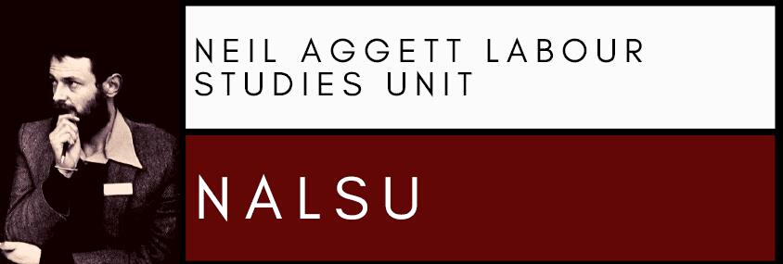
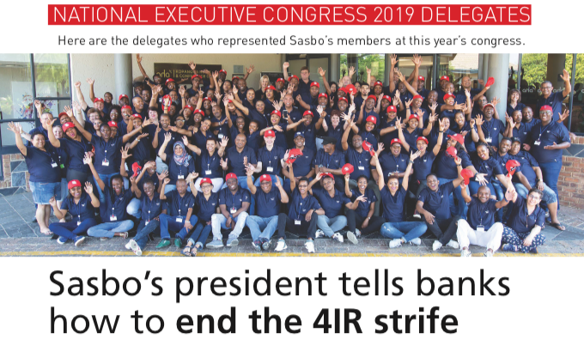

Are Unions Still Relevant?
Power, Prospects and Pitfalls
(by Professor Lucien van der Walt)
Neil Aggett Labour Studies Unit (NALSU)
6 September- 2022

Slide 2
1. Introduction
This seminar will discuss:
Power: unions still matter
Pitfalls: external and challenges
Prospects

Slide 3
2. Unions still matter: size, structure, survival
“Death of class” thesis: working class vanishing?
BUT
Majority of world now depends on wages
Inequality in power, wealth is stark everywhere

Slide 4
“Death of unions” thesis: unions dying off, irrelevant, impotent
BUT
Unions are the 1. largest, 2. formal & and 3. stable civil society organisations (after religious bodies)
Largest:
17% of wage]earners worldwide are unions
  Minimal presence among managers (interests), domestic workers (conditions) = higher rate if adjusted
  Lowest rate is Asia

Slide 5
214 million members in 150 countries
ITUC: 207.5 million in 331 federations in 163 countries, territories
Africa:
12% of global union membership (2018)
union membership has grown steadily (from 2008)
Southern Africa:
union density of 24.9% (2016)
only exceeded by North Africa (33.9%) & northern Europe (63.2 %)

Slide 6
South Africa:
union density of 29% (2022)
collective bargaining covers 31% of employed workers
remarkably stable in absolute numbers: hovers around 3.5 million
unusual given mass unemployment in wage-dependent economy

Slide 7
2. Formal:
Webbs: Unions are continuous associations of wage-earners for the purpose of maintaining / improving the conditions of their working lives
ILO: Unions are independent workers’ organisations constituted for … furthering and defending the interests of workers…

Slide 8
They are formalised movements
They are essentially voluntary
This is true even where pressures are exerted by
  agency fees
  closed shops
  specific welfare systems
(This excludes state-run pseudo-“unions” e.g. China, Vietnam)

Slide 9
3. Stable
From emergence in 1840s in UK, unions proved resilient
(Very early) emergence of unions in South Africa:
Earliest in southern Africa
Blue-collar unions 1880s onwards:
  1881: Amalgamated Society of Carpenters & Joiners (craftsmen only)
  1902: Transvaal Miners Association (industrial)
  1917: Industrial Workers of Africa (all-in/ general union)

Slide 10
White-collar unions 1910s onwards:
  1916: SASBO
  1920: Public Servants Association (PSA)
  1920: Salaried Staff Association (SALSTAFF)
  1920: Transvaal Native Mine Clerks Association

Slide 11
Some unions are short-lived, some self-destruct
But most are remarkably durable & able to renew:
Society of Carpenters went through various mergers, ending up in UASA
Transvaal Miners Association evolved into Solidarity
  300 (1902) → 140,000 in 2020
PSA is the 2nd biggest government union today
  5,500 in 1926 → 235,000 in 2020
SASBO is today’s largest finance sector union
  400 in 1918 → 73,000 in 2019

Slide 12
Some COSATU and ex-COSATU unions have similar pedigrees:
SAMWU was co-founded by union from 1926: CTMWA
FAWU was co-founded by union from 1941: A/FCWU

Slide 13
3. Unions still matter: role and impact
1. Unions shape labour markets, working conditions
Media pundits: strikes leads to wage losses higher than wage gains
BUT this only applies to protracted strikes
Union “wage premium” e.g. Butcher, Rouse, 2001:
20% for unionised black African workers
10% for unionised white workers
6-10%: non-union black African workers covered by bargaining council agreements

Slide 14
Media pundits: unions interfere in labour markets = job losses
Unions can lead to job losses
BUT
SA mass unemployment precedes powerful unions: 1970s
Highest in non-union areas e.g. rural areas, small towns

Slide 15
“Flexibility” and wage levels do not translate neatly into jobs
  Sweden has a high-wage (& rigid) labour markets + low unemployment
  SA has (mostly) low-wage (& flexible) labour markets + mass unemployment
Real wages in SA (generally) stagnated 1997-2013
Median real wages declined in agriculture and manufacturing
Median earnings in 2013 were low incl. in business services
Most wage settlements are around 2% gains in real terms

Slide 16
Other causes of unemployment are outside union control:
  Mechanisation and new technology
  Primary role of investor confidence
    e.g. infrastructure, law & order
  Skills and competitiveness
  Small markets

Slide 17
2. Shaping larger society
Political and legal reforms
e.g. 1995 LRA: almost complete inclusion of workers
(against the tide…)
e.g. “state capture”
COSATU: 27th September 2017 S77 national strike

Slide 18
Promoting policy alternatives
e.g. 1994: RDP
e.g. 1995: NEDLAC Labour Caucus’s “Social Equity and Job Creation prooposals
e.g. 2016 +: SASBO campaign on 4IR in financial sector

Slide 19
3. Democracy, empowerment at distance from the state
Key to strong civil society
  Size, resources, durability
  structural power
  Inclusive “class” identity
Foster voluntary associational life and solidarity
  Importance of realm between state and individual
Scope for daily practice of democratic participation

Slide 20
4. Education and information
Internal education
  Rights
  Issues of the day
  Social theory
Vocational training
Accessing higher education
Credit to unions: key in winning “RPL” system

Slide 21
4. Pitfalls
Narrowing policy space
Since 1930s, unions in SA (& elsewhere) banked on “enabling state”
1970s: start of shift towards neo-liberal globalisation
  Commercialisation & privatisation
  Open a markets
  Flexible labour
  austerity spending
Problem of demand-led growth in increasingly open economies
The “race-to-the-bottom” and the “Chinese price”

Slide 22
2. SA’s fraught neo-liberal transition
Policy incoherence
Fractured (party-)state (state form)
Contradictory measures
e.g. ESKOM restructuring from late 1980s
  freeze expansion in 1990s, 2000s
  cut maintenance: 66,000 staff (1984) → 30,000 (2004)
  = high profits e.g. rose 37% from 2000-2001
  = inadequate power supply
  = reduced investment
  = ballooning debt

Slide 23
Looming fiscal crisis
“national debt” to cover deficits: currently R4.3 trillion
costs R500 billion a year
another R2 trillion of debt sitting in SOEs

Slide 24
    Source: Lucien van der Walt, 23 July 2022, “Contextual Discussion: The Current Conjuncture and the Broad Working-Class,” Makukhanye Rural Movement: Strategic Workshop/ Khanyisa Educational and Development Trust, Gqeberha.
    `

Slide 25
Spending more than earning
ballooning welfare demand
COVID-19 relief
corruption, wastage, litigation
SOE, municipal bail-outs
high executive & politician salaries
e.g. RTMC’s CEO: R9 million (inc. R3.7 mn bonus) 2020/21 financial year.
Limited tax revenue
corruption/ evasion
limited base / prospects
low growth
need to attract / retain investors

Slide 26
3. The “social partners” are not equals
Interdependent, not equals
Power & wealth centralised in economic & political elites
i.e. a “ruling class”
States, corporations have
  Centralised (top-down) power structures
  Vast administrative, coercive, economic resources
  Vast incomes e.g. taxation
Few union policy alternatives are adopted
  Viability (neo-liberal, SA context)
  Power relations
  Different class interests

Slide 27
4. Social decay and the “neo-liberal subject”
Flexible labour, outsourcing, competition, job-hunting, poverty
Weakening of social bonds, mass movements, associational life
Social decay in township, working-class communities, families
The isolated “neo-liberal subject” with “friends” and “likes”
Politics of fear: crisis, short-termism, powerlessness, escapism
‘
Factionalism, intolerance, rage, mobbing

Slide 28
Media including social media based on
Managed narratives
Bad news sells
“war journalism”
The blurring op-eds and real news
Celeb culture
“Woke” capitalism

Slide 29
5. Problems in the unions: coverage
Stagnating numbers
Absolute numbers steady but a declining proportion of workers
Losses hidden by expansion in new areas
e.g. private sector: factories, shops, textiles
e.g. universities, municipalities
        e.
Huge gaps e.g. farms
Splits and realignments: redividing the “cake,” poaching
70% remain outside unions

Slide 30
6. Problems in the unions: mission drift
Factionalism: resource battles, spill-over of party battles
Tails wagging dogs: investment companies
The above show unions enmeshed in parties, state, business
= losing autonomy

Slide 31
Violence between workers/ unions vs workers’ unity
= most strike violence is against other workers
Decline of political tolerance vs workers’ own loyalties
  e.g. COSATU actions around ANC/ Zuma vs COPE/ Mbeki
Reflect divides in working-class
  Age
  Gender
  Politics
  Race
  Skill / jobs
  etc

Slide 32
Decline of workers’ control in unions
  Alienation, cynicism
  Corruption
  Loss of hope
  Weakness: it is not “efficient”
State and corporate “logic”
= top-down, centralised, elitist
= minority rules society
Union “logic”: bottom-up, decentralised, “popular”
= part of society, majority

Slide 33
7. Problems in the unions: growing isolation
Unions only organise part of broader working-class
  Non-union workers
  Unemployed workers
  Workers’ communities, families
Little impact on the public sphere

Slide 34
Public trust deficit:
Public trust in unions dropped to 29% (HSRC report, 2013)
  Only 53% of Coloureds
  Only 35% of black Africans
  Only 40% of “lower class”
  Only 53% of Coloureds
(Only politicians fared worse: 21%)

Slide 35
But alliances, outreach, public image all in dire state:
  Corruption scandals, factionalism
  Strikes that alienate
  e.g. the ambulance story
  e.g. municipal services
  e.g. ESKOM
  Minimal alliances around
    e.g. township conditions
  Image of undue closeness to government
  Minimal media work

Slide 36
7. Problems in the unions: the loss of a vision
Impractical & ignored proposals (see earlier)
Challenges of new systems e.g. 4IR
  Design and application of new technology is not neutral
  Unions usually struggle to negotiate technological change
Crisis of “left” as “enabling state” vanishes
The smaller efforts no longer fit any obvious grand goal, future, new system

Slide 37
5. Prospects
A “long march” to (re)build unions
Rebuild and revitalise
  Organise the unorganised: don’t redivide the cake
  Autonomy from business, party system, state
  Debate and political tolerance
  Alternative mass media incl. social media, video
Rebuild union-community alliances
  Anti-corruption: ethical politics
  Respect your neighbours
  Win-win actions
  Self-help e.g. clean-ups
  Alternative institutions e.g. clinics, halls, co-op

Slide 38
In unions and communities, foster
  Solidarity and humanity
  Ethical, caring interpersonal relations
  Associational life, self-governance, self-reliance
  Education, including vocational
Building a “counter-power”
Prefiguration: be the change you want to see

Slide 39
The big picture
Mass job creation, reindustrialisation
  Not grants, “delivery,” dependence
  Decent, secure work
Phase out the township system, low-grade education
Extend real working-class control over economy, society

Slide 40
References
Union density
Southern Africa: J. Visser, 2019, Trade Unions in the Balance, ILO ACTRAV Working Paper, ILO: Geneva, esp. pp. 14-16
South Africa: ILO, "Statistics on union membership," online at https://ilostat.ilo.org/topics/union-membership/, accessed 14 June 2022
Unions and wage premiums
K.F. Butcher & C.E. Rouse, 2001, "Wage Effects Of Unions And Industrial Councils In South Africa," Industrial & Labor Relations Review, vol. 54, no. 2, pp. 349-374
C. van der Westhuizen, H. Bhorat & S. Goga, 28 May 2013, “How Much Do Unions and Bargaining Councils Elevate Wages?,” Econ3x3, online at http://www.econ3x3.org/article/how-much-do-unions-and-bargaining-councils-elevate-wages, accessed 14 June 2022
.

Slide 41
Wage trends cited
T. Elsley & G. Mthethwa, 2014, “Wage Determination in South Africa since 1994,” Bargaining Indicators 2014: Twenty Years - A Labour Perspective, vol. 14, pp. 19-24
Unions and public trust
S. Gordon, B. Roberts & J. Struwig, 2013, “The State of the Union?,” HSRC Review, vol. 11, no. 1, pp. 7-9
The culture of fear
B. Elliott, 2021, The Roots of Populism: Neoliberalism and Working-Class Lives, Manchester: Manchester University Press

